Slide 1
FACULTY CENTER
the
at A-State

Slide 2
GINA HOGUE associate dean, CLAC
RUTH OWENS faculty fellow
LESLIE PARKER faculty fellow
DEAN MURRY faculty support specialist
CHRIS EARNHART faculty support specialist
here to help

Slide 3
contact us
Library Suite 301
www.astate.edu/facultycenter
870-972-2334

Slide 4
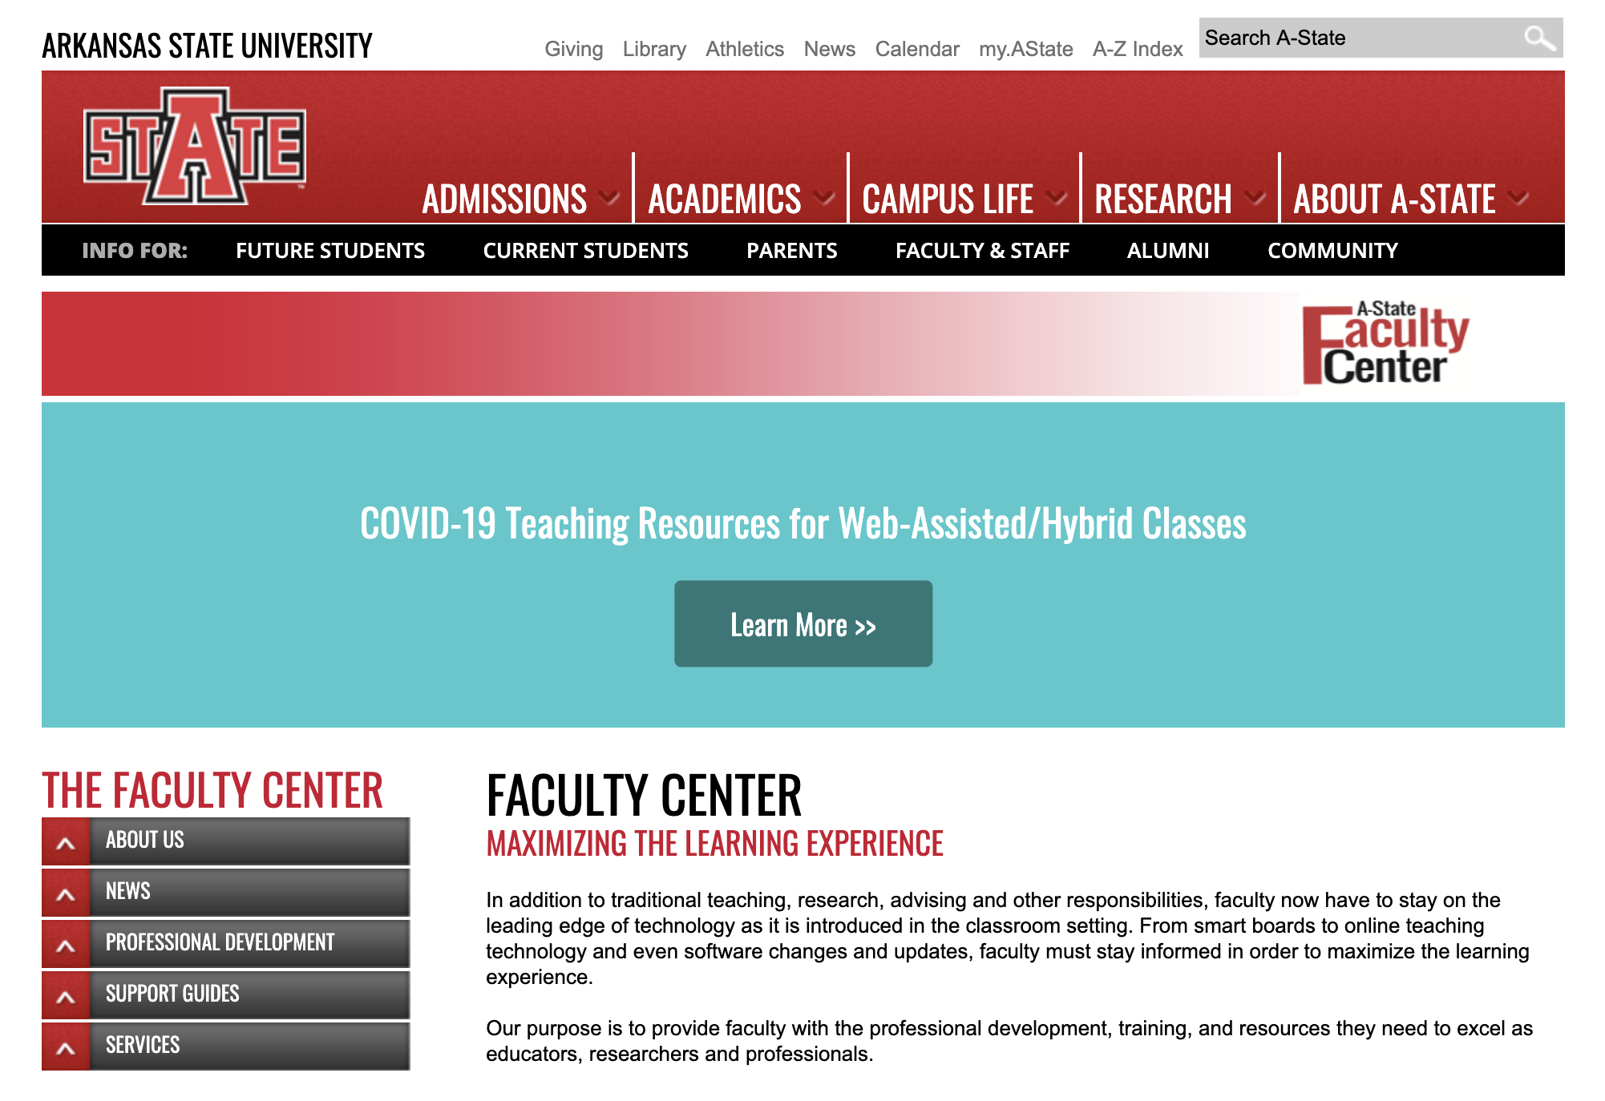

Slide 5
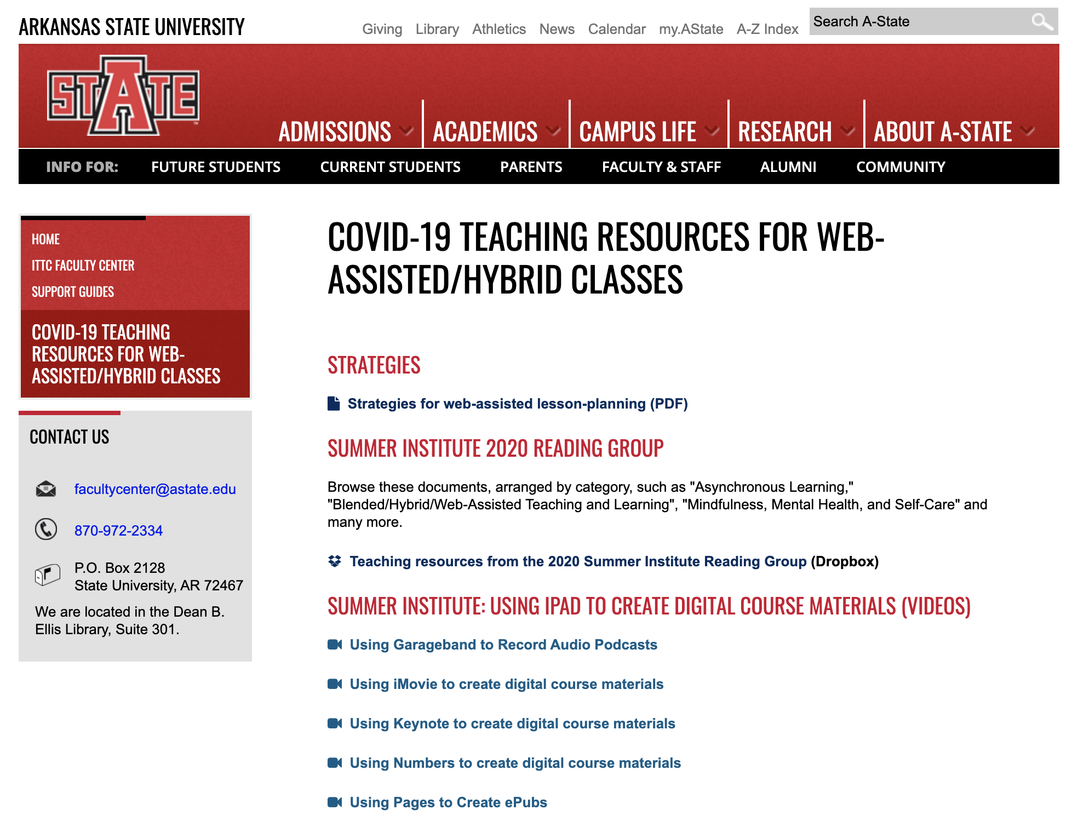

Slide 6
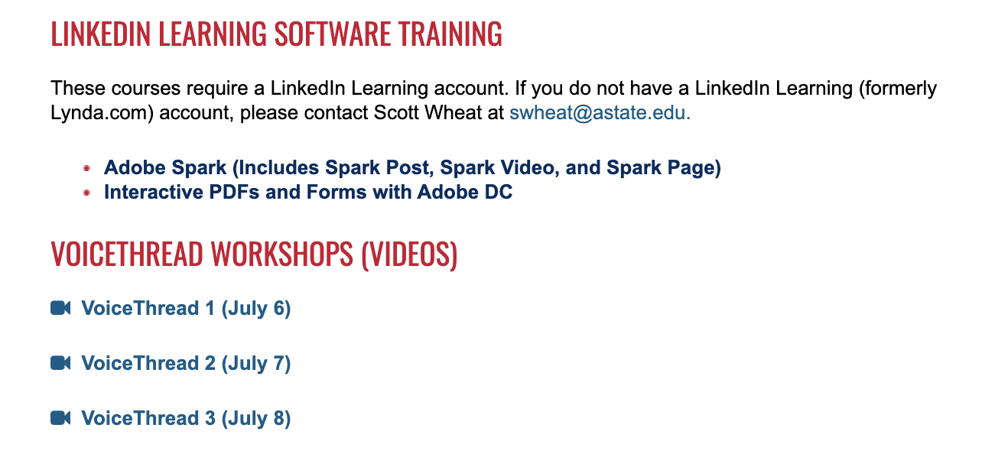

Slide 7
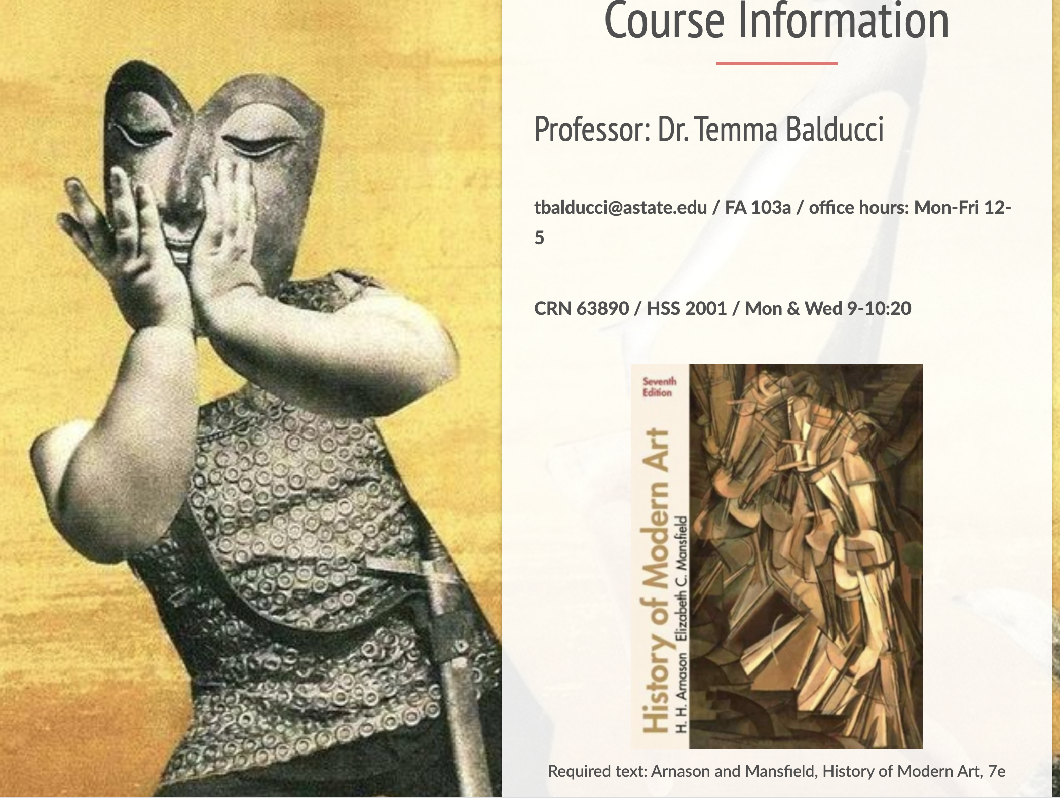
Creating Engaging Syllabi
A-State Summer Institute 2020
Website created by
Dr. Temma Balducci

Slide 8
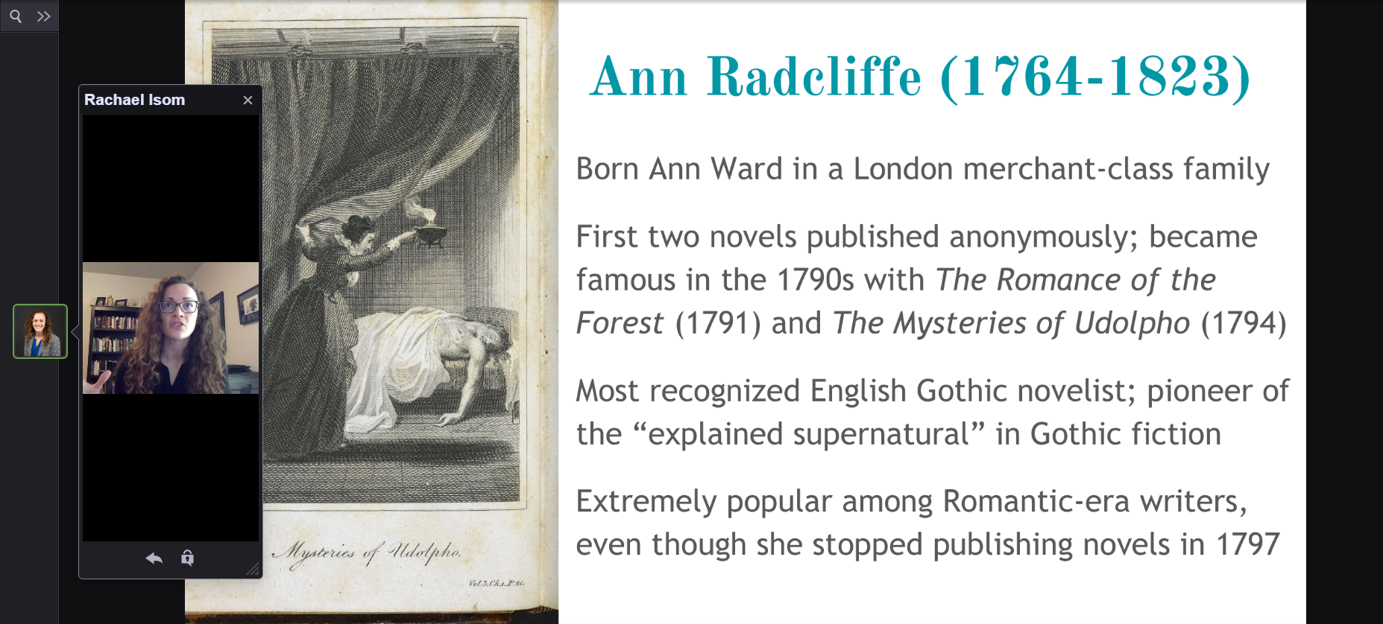

Slide 9
get access to Adobe
Creative Cloud
https://astate.easyvista.com/

Slide 10
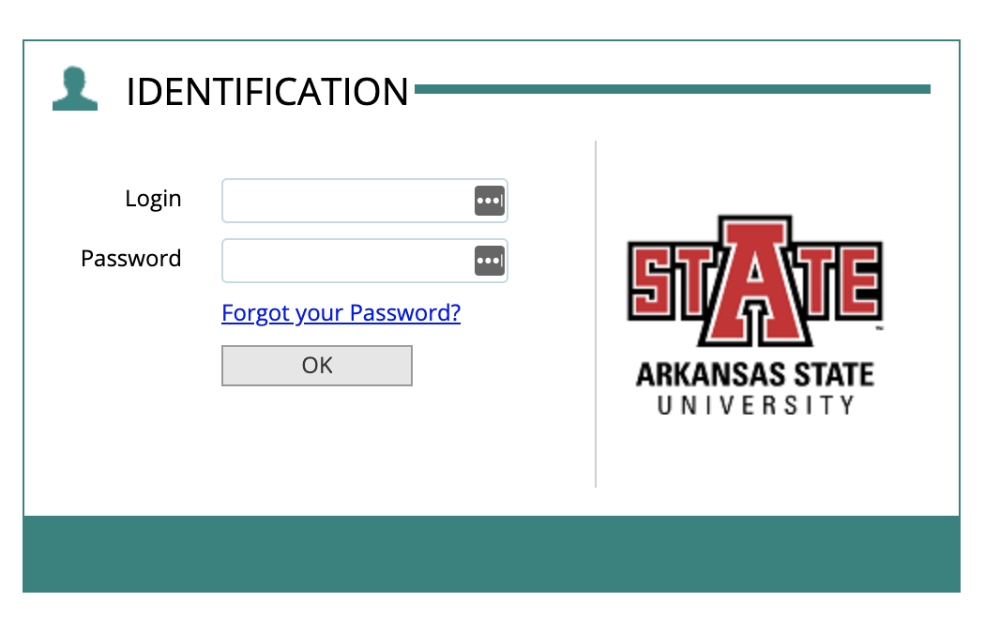
The first part of you’re A-State email address.
Example: yourname@astate.edu
The password for your
A-State account.

Slide 11
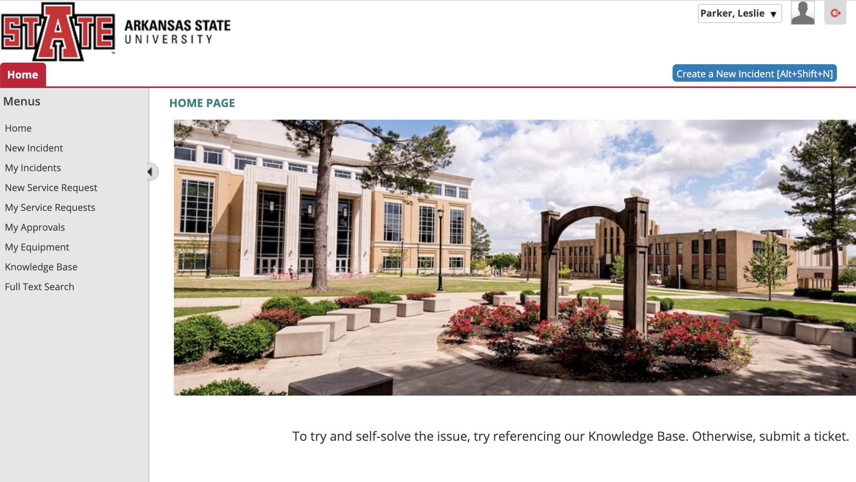

Slide 12
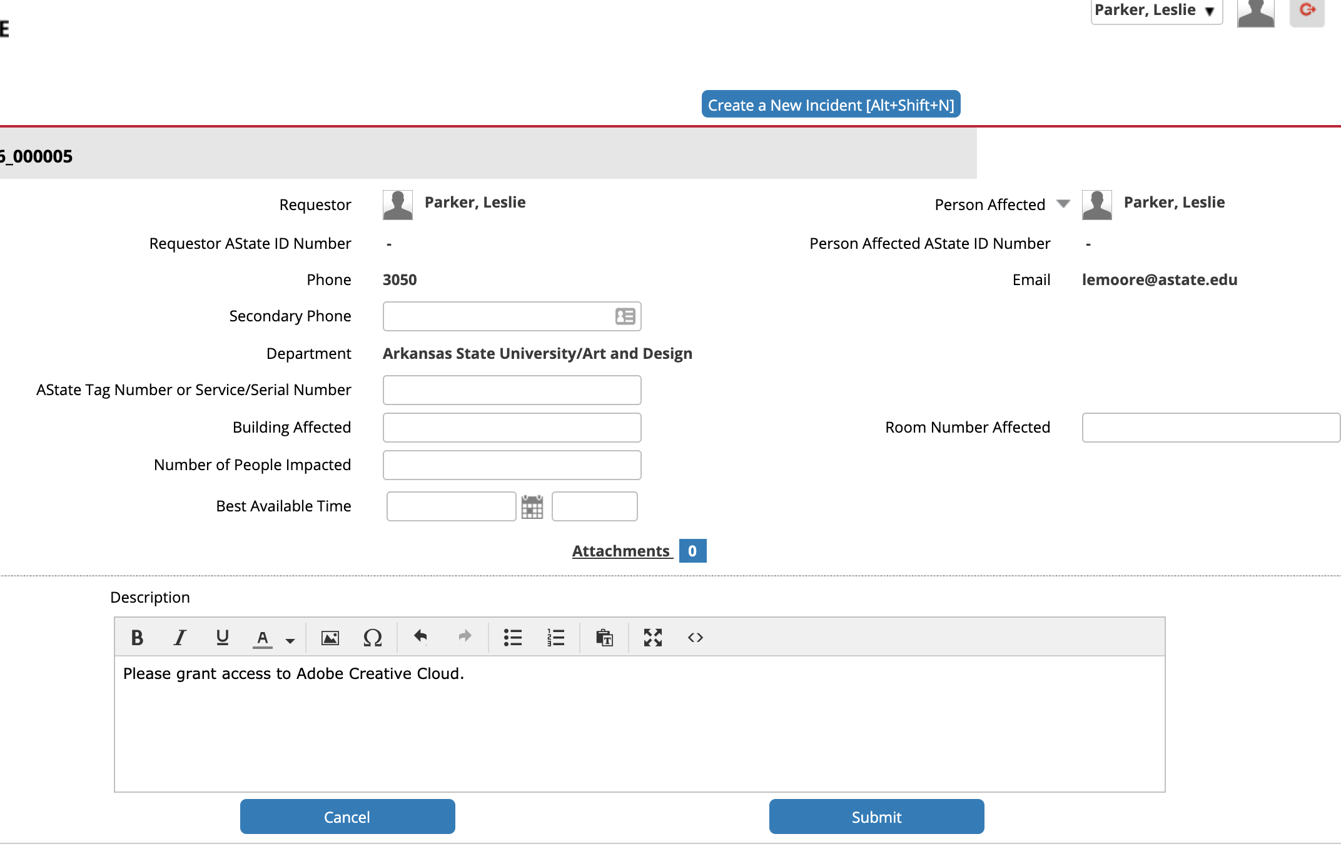

Slide 13

book club

Slide 14
contact us
Library Suite 301
www.astate.edu/facultycenter
870-972-2334

