Slide 1

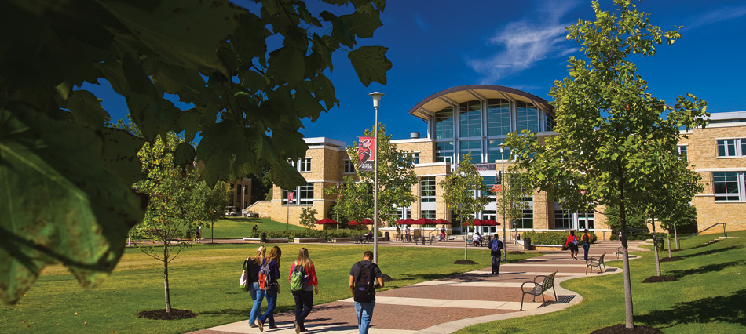

New Faculty Orientation
presented by: Dr. Lori A. Winn,
Assistant Vice Chancellor for Human Resources
AState.edu
/ArkansasState
@ArkansasState

Slide 2
A-State Objectives for COVID-19
Committed to maintain the health & safety of our faculty, staff and students.
The university’s mission is to educate leaders, enhance intellectual growth and enrich lives.
A-State will continue to deliver the highest quality learning and working environment during this unprecedented time.
Procedures related to the ongoing COVID-19 pandemic will be guided by information from the Centers for Disease Control and Prevention, Arkansas Department of Health and Governor Asa Hutchinson’s Office.
AState.edu
/ArkansasState
@ArkansasState

Slide 3


Our Health Depends on Everyone
Aggressive Hygiene
Reduce your exposure
Hand-washing 20 seconds
Mask wearing
Do not come to work/class with
  COVID-19 symptoms
Physical Distancing
Minimum of six feet at all times
Don’t move furniture
Avoid becoming a direct contact
Close Contact
A close contact is:
Less than six feet apart
For more than 15 minutes
Results in quarantine
AState.edu
/ArkansasState
@ArkansasState

Slide 4
Face Coverings & Masks
A-State employees and students must wear a cloth face covering on campus to minimize the potential for COVID-19 virus spread.
Face coverings should be worn when entering and exiting any building.
Instructors in the classroom, may opt for a face shield as circumstances require.
During class, students must wear appropriate face coverings for the duration of a class period.
Faculty must wear face coverings when attending meetings or other events where physical distancing rules cannot be followed. This also includes office hours or other instructional meetings outside of the traditional classroom.
AState.edu
/ArkansasState
@ArkansasState

Slide 5
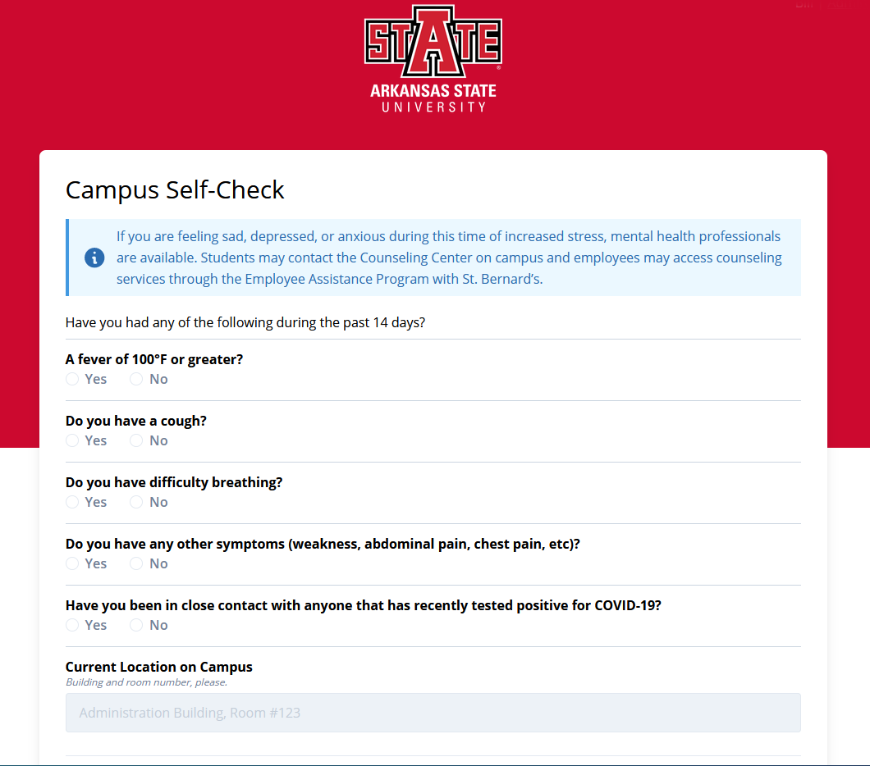
Campus Self Check Form
AState.edu
/ArkansasState
@ArkansasState

Slide 6
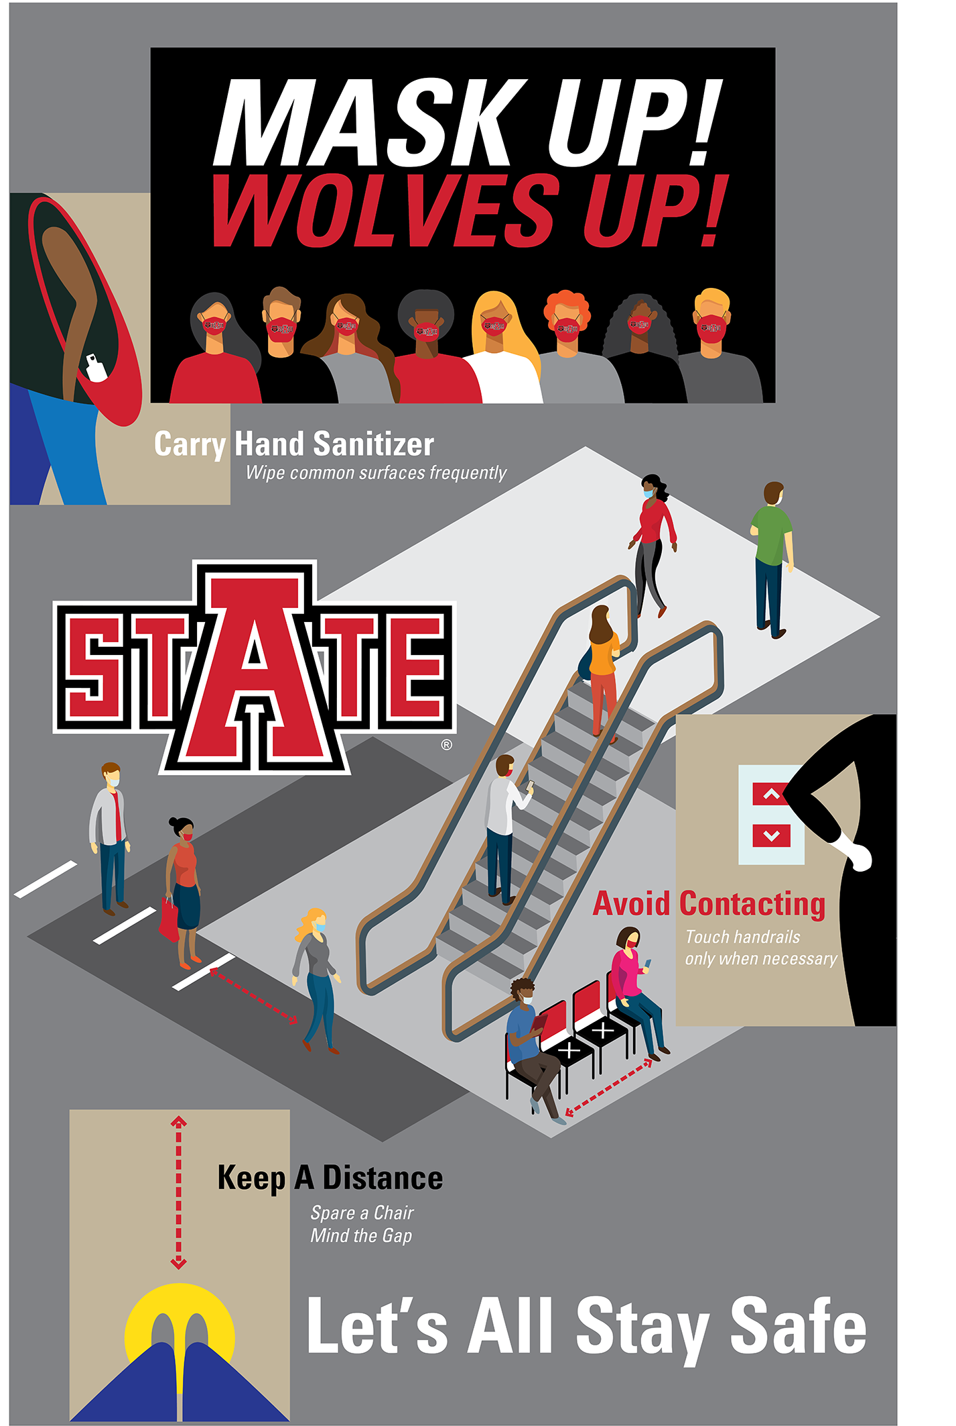

Follow the signage
Physical Distancing
Watch for dots/lines for lines
Walk on the right side of hallways, stairwells
  Anytime six-foot spacing is not possible
Do not move or rearrange furniture
Avoid using elevators
  Two person limit on all elevators
AState.edu
/ArkansasState
@ArkansasState

Slide 7
Protective Measures in the Classroom
Classrooms have been designed to limit direct contact.
Students and faculty members are asked to properly sanitize all surfaces used, upon entering the classroom.
Instructors may request students to leave the classroom if the student fails to comply with wearing some form of appropriate face covering.
Adopt and use the COVID-19 course syllabus language.
Physical contact in the classroom should be discouraged or prohibited. If an assignment requires students to be in physical contact (touching each other), a plan should be submitted to the EOC.
AState.edu
/ArkansasState
@ArkansasState

Slide 8
What Happens If a Student is Sick?
Students exposed to COVID as well as those who test positive and are asymptomatic can continue their studies remotely while in quarantine if a remote learning opportunity exists.
At times, students may become too sick to work remotely. Faculty will work with students following their usual process for missed courses. Due to the unique circumstances presented by COVID-19, faculty will be expected to allow flexibility, where possible.
In some cases, students may need to withdraw from the course or a grade of “I” may be issued.
Learning Support Services may be an option for students in need of a learning coach.
AState.edu
/ArkansasState
@ArkansasState

Slide 9
What Happens If I am Sick?
Faculty exposed to COVID as well as those who test positive and are asymptomatic may transition teaching to remote teaching while in quarantine.
If you become too sick to work remotely. Faculty should contact the Department Chair and follow typical process for missed classes. Preparation is the key for these circumstances.
If unable to teach, also contact Human Resources to discuss leave options.
AState.edu
/ArkansasState
@ArkansasState

Slide 10
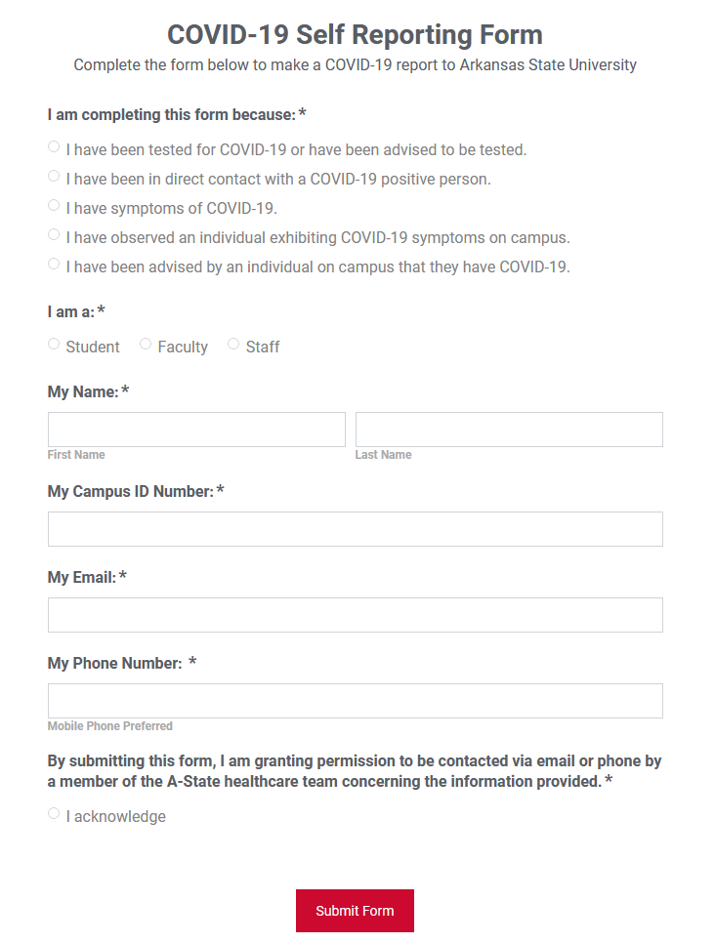
Self-Reporting Form
AState.edu/COVIDSelfReport
When to use the form:
You have been tested
You believe you have had direct contact
You have COVID-19 symptoms
You have observed an individual with symptoms on campus
You have been advised of someone with COVID-19
AState.edu
/ArkansasState
@ArkansasState

Slide 11
Isolation vs. Quarantine
Isolation = Positive
Individuals who have tested positive for COVID
Minimum 10 days isolation
Isolated until all three are achieved:
  24 hours with no fever without medicine
  Symptoms have improved
  At least 10 days since test or symptoms started
Quarantine = Exposed
To limit further spread
You were a close contact of a positive COVID case
14 days of self-isolation from day of contact
  Contact tracers may call and alert you
Tested = Quarantine
If you have been tested, DO NOT return to class/work
Physician and/or contact tracers will advise your next steps
AState.edu
/ArkansasState
@ArkansasState

Slide 12
Contact Tracing
NYITCOM at Arkansas State
Partnering with ASU System
Supporting contact tracing of A-State cases
On-campus testing for COVID-19
  At NYITCOM Health Clinic near stadium
  Additional location opening soon
If you receive a call . . .
Contact tracers will keep your information confidential
Please comply with information
  If you are the case, be honest
  If you are being traced, be ready to quarantine
Follow protocol if you are asked to test
  Call ahead to alert your health care provider
  Do not return to class or work until released
AState.edu
/ArkansasState
@ArkansasState

Slide 13
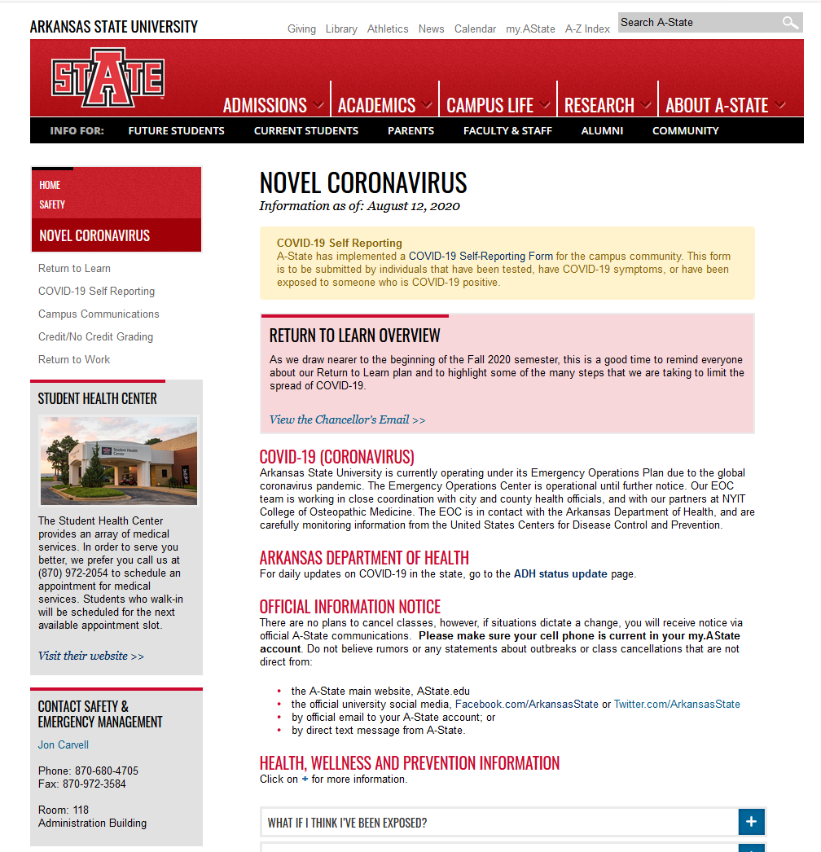
Additional Information?
More info: AState.edu/Coronavirus
AState.edu
/ArkansasState
@ArkansasState

